Slide 1
A Programming Career for Everybody
The path to the master programmer
Dr. Charles Severance
University of Michigan School of Information

Slide 2
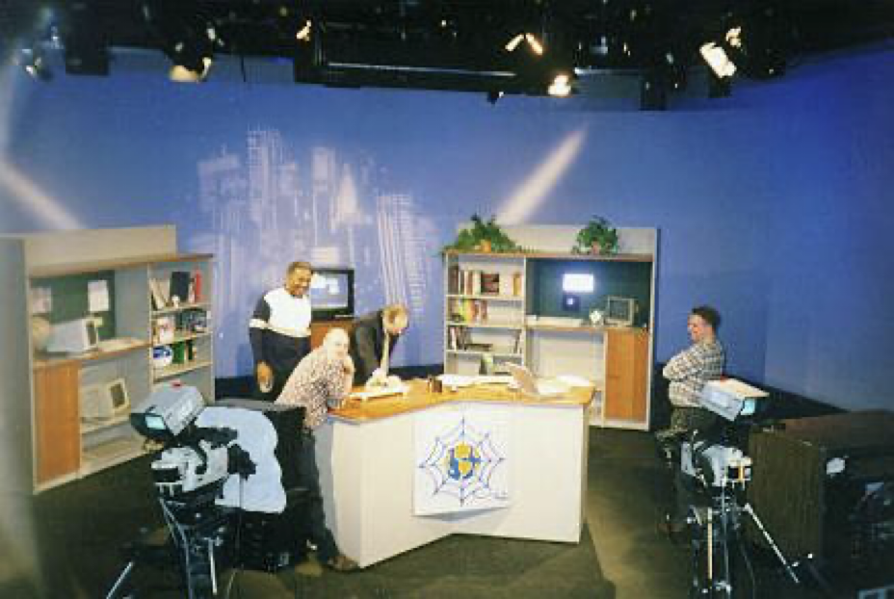
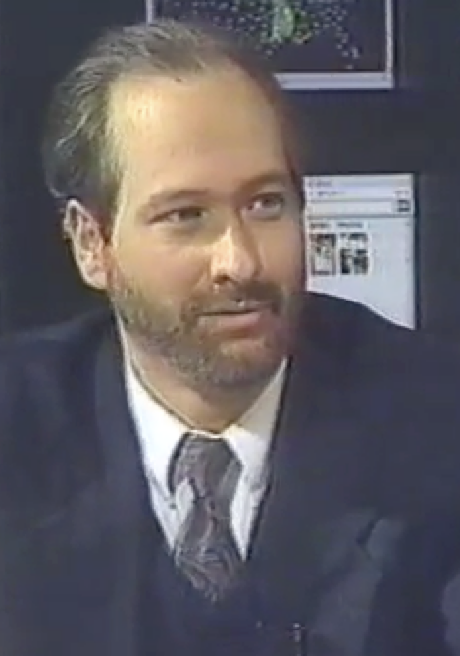
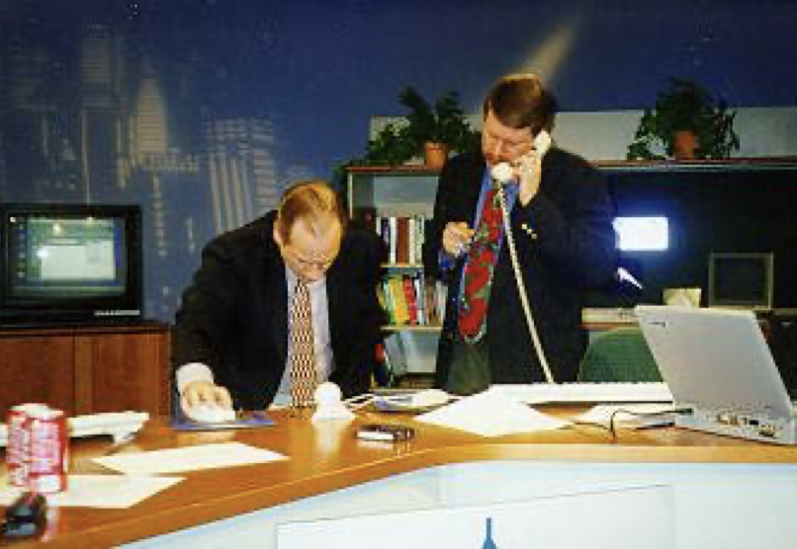
TV "Personality"
Sponsored and distributed by Cable television networks
East Lansing, MI
Promote Cable Modems
Internet:TCI (1996-97)
Nuthin' but Net (1998-99)
Pre-Internet Influencer

Slide 3
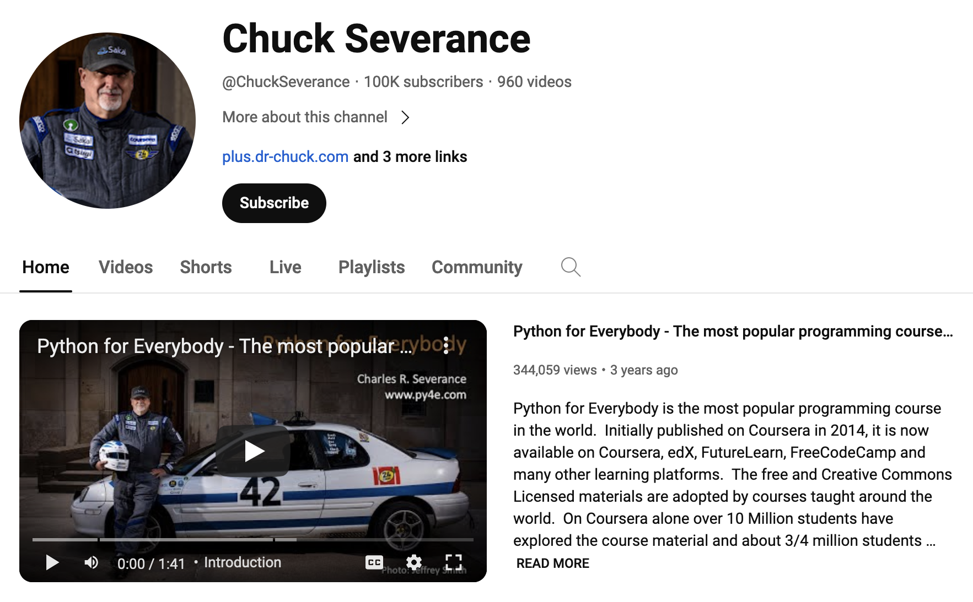
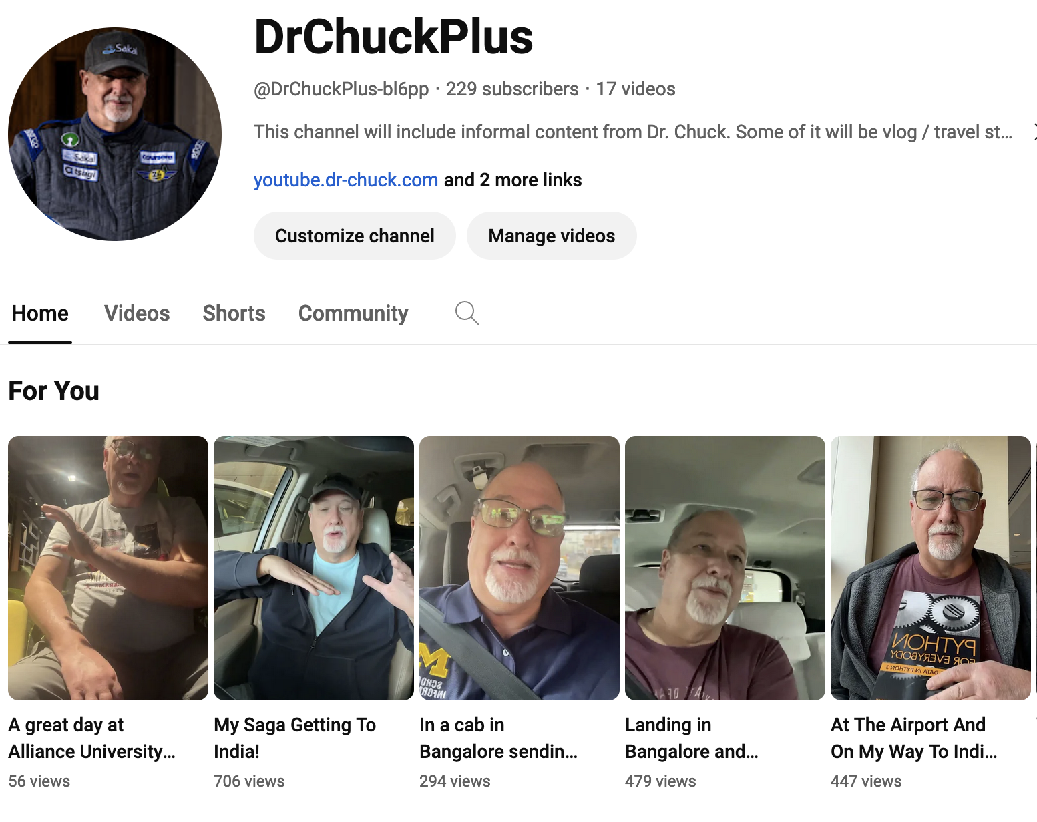
plus.dr-chuck.com
youtube.dr-chuck.com

Slide 4

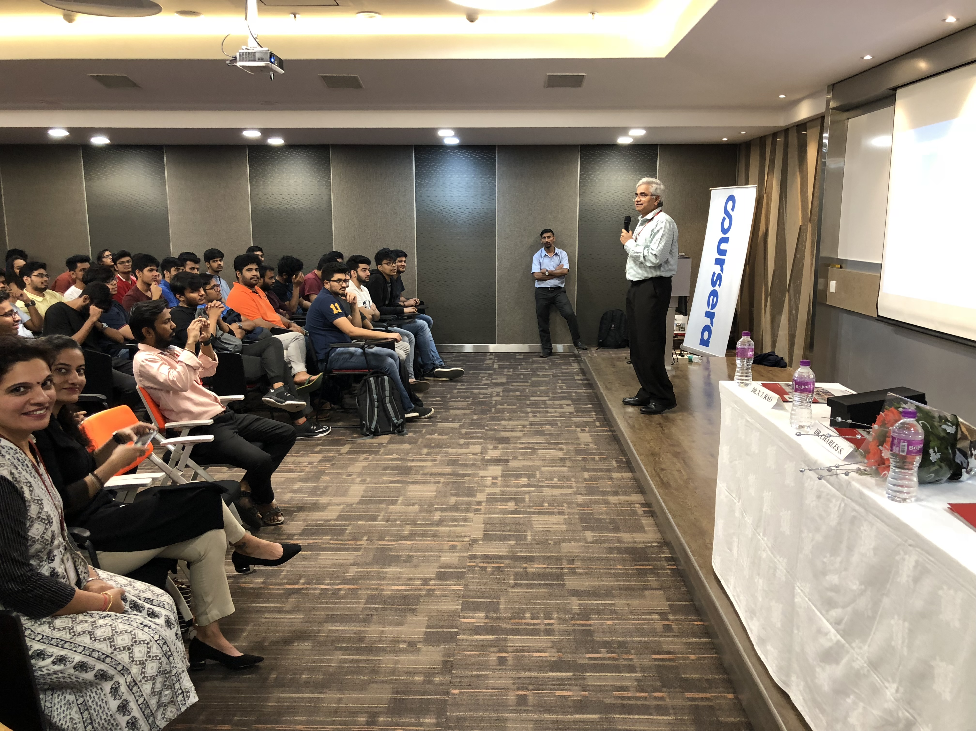
I came to India with Coursera in 2018
In addition, by 2030, India will have
the largest number of people of
college-going age - a staggering 140
million. Currently, 736 universities
educate 28.6 million students. India
will need at least another 1,500
institutions by 2030 to accommodate
this huge influx of students.
https://www.ukibc.com/wp-content/uploads/2018/03/2018-06-14-India-Education-Policy-Web-version.pdf

Slide 5
Six Years Later (halfway to 2030)
Online Degrees from Indian Universities on Coursera
BITS Pilani's BSc in Computer Science
IIT Guwahati's BSc in Data Science & AI
IIIT Hyderabad's MSc in Information Technology
Coursera for Campus
Supplement on campus and online education to extend teaching resources
Python for Everybody ☺

Slide 6
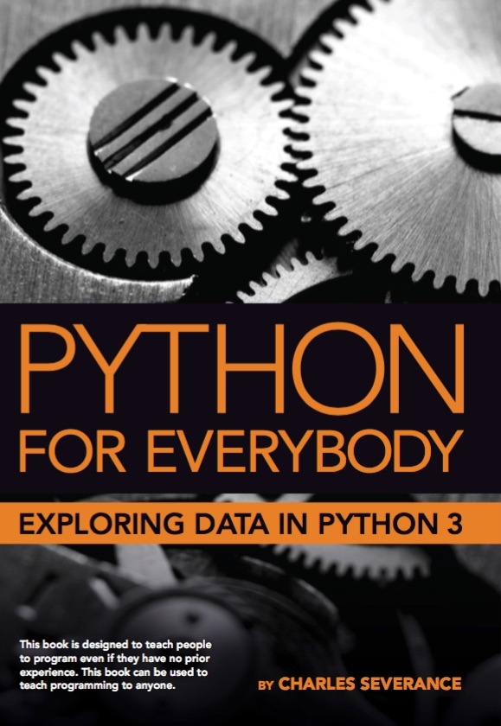
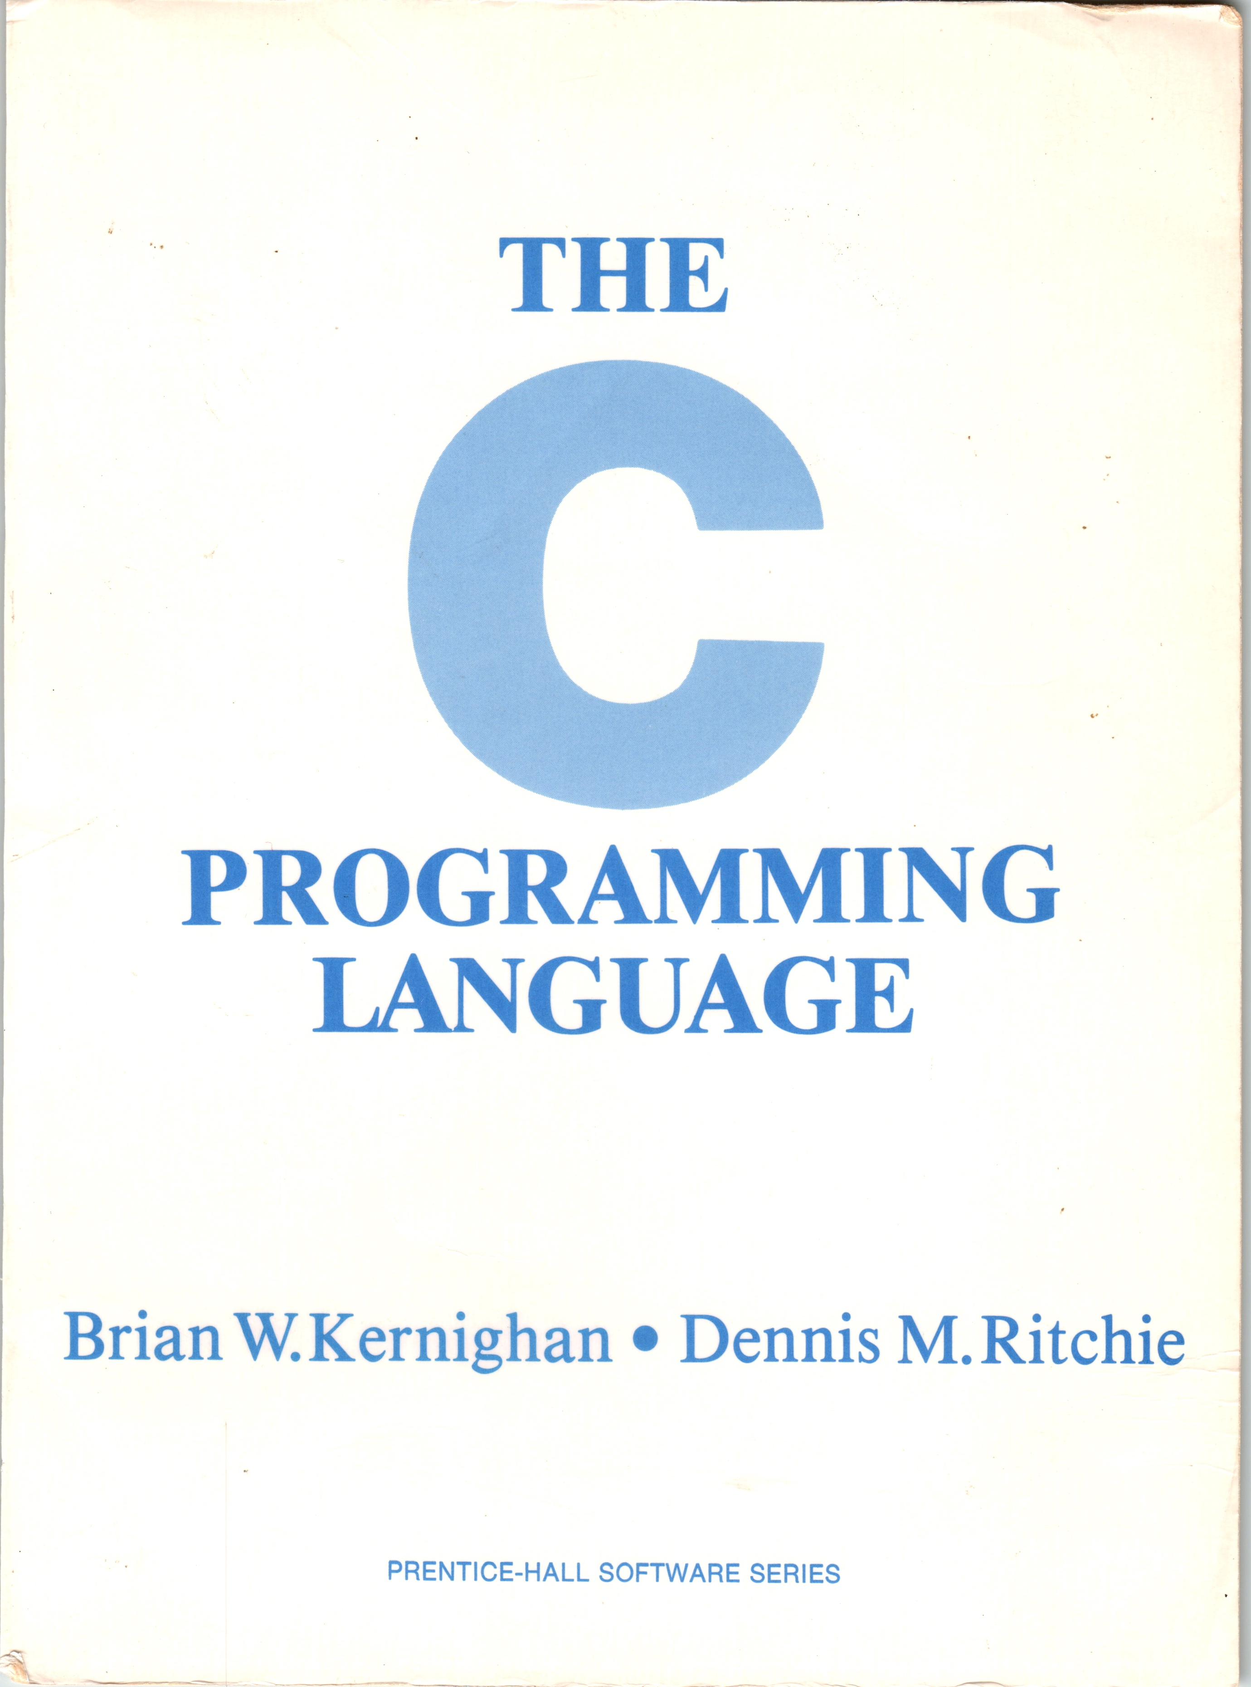
A Tale of Two Books, 10 years, and Coursera
Coursera: Python for Everybody (2013)
Coursera: C Programming for Everybody (2023)

Slide 7
Coursera: Python for Everybody
Introduced in 2013, Updated 2016, 2024
The most popular programming course in the world
Translated into 10+ Languages
In browser development environment
Many auto-graded exercises
Extra – more than just a course
Interviews
Office Hours

Slide 8
Who is "Everybody"?
Pre-college students preparing for college
College students taking a challenging course
Working adults that want to take the next step in their career
Older adults with free time and want to "see if they can do it"
Successful people that want to try "something else"

Slide 9
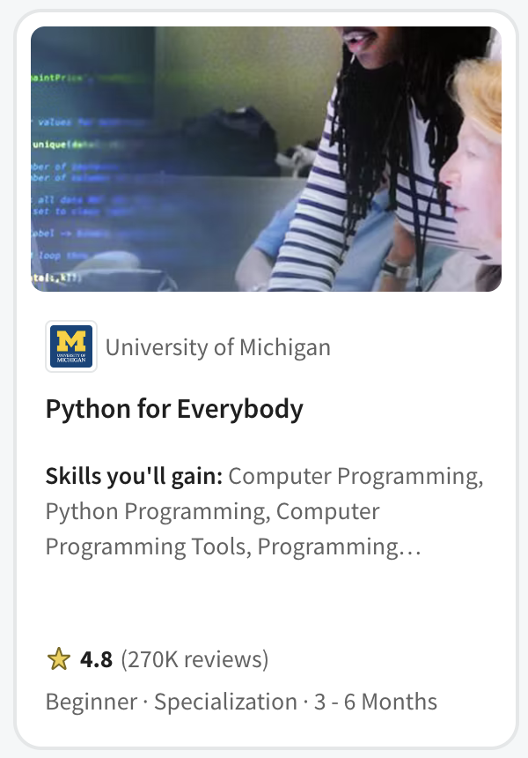
PY4E (2013)
Not a first course in Computer Science
Programing for Librarians
Quickly became the pre-requisite for
John Hopkins Data Science
Rice University Interactive Python
University of Michigan Python 3
University of Michigan Statistics with Python
University of Michigan Applied Data Science with Python
University of Michigan Masters of Applied Data Science
Popular in Coursera for Campus - India

Slide 10
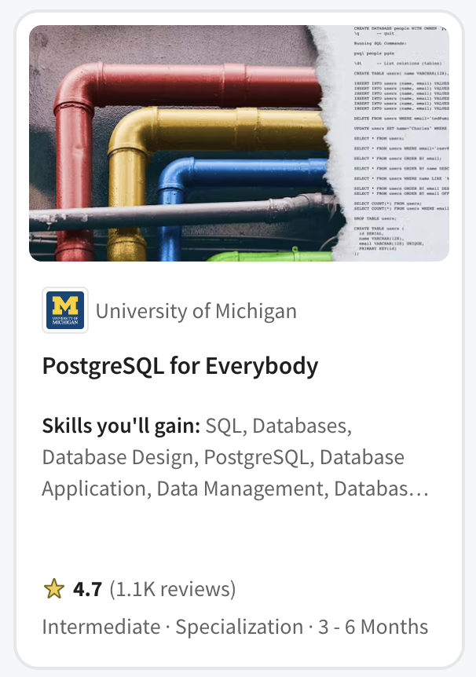
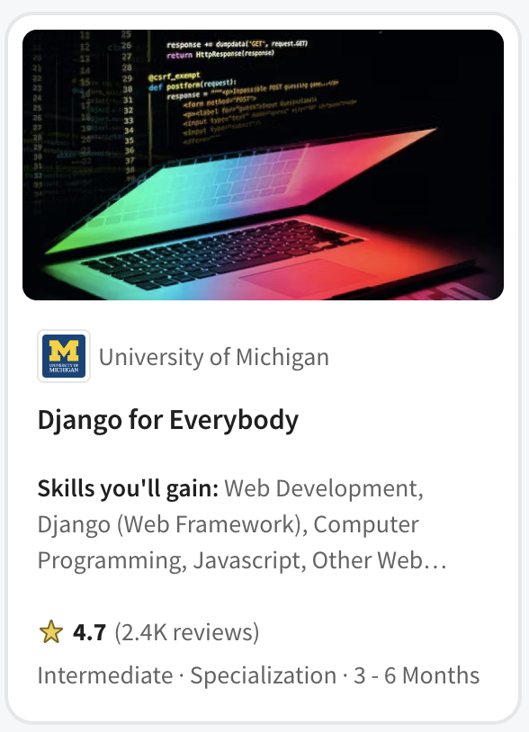

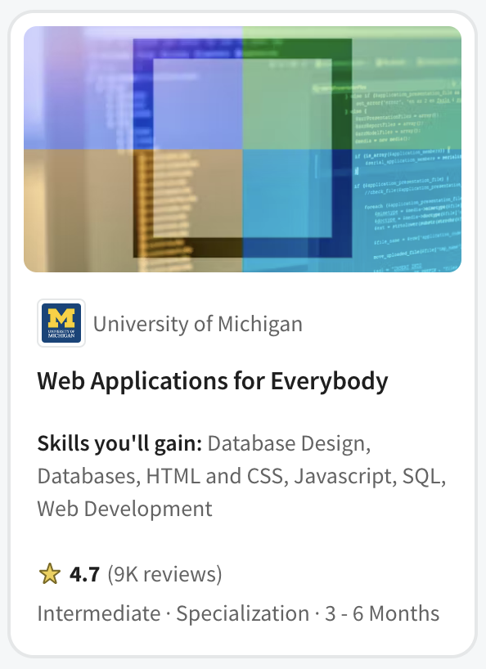

Slide 11

Every day 150 students complete one of my courses around the world

Slide 12
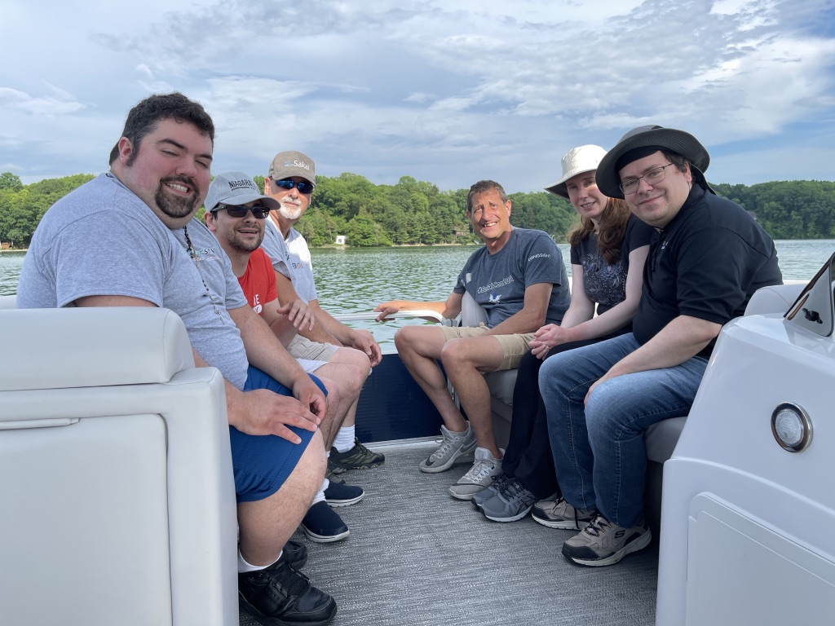
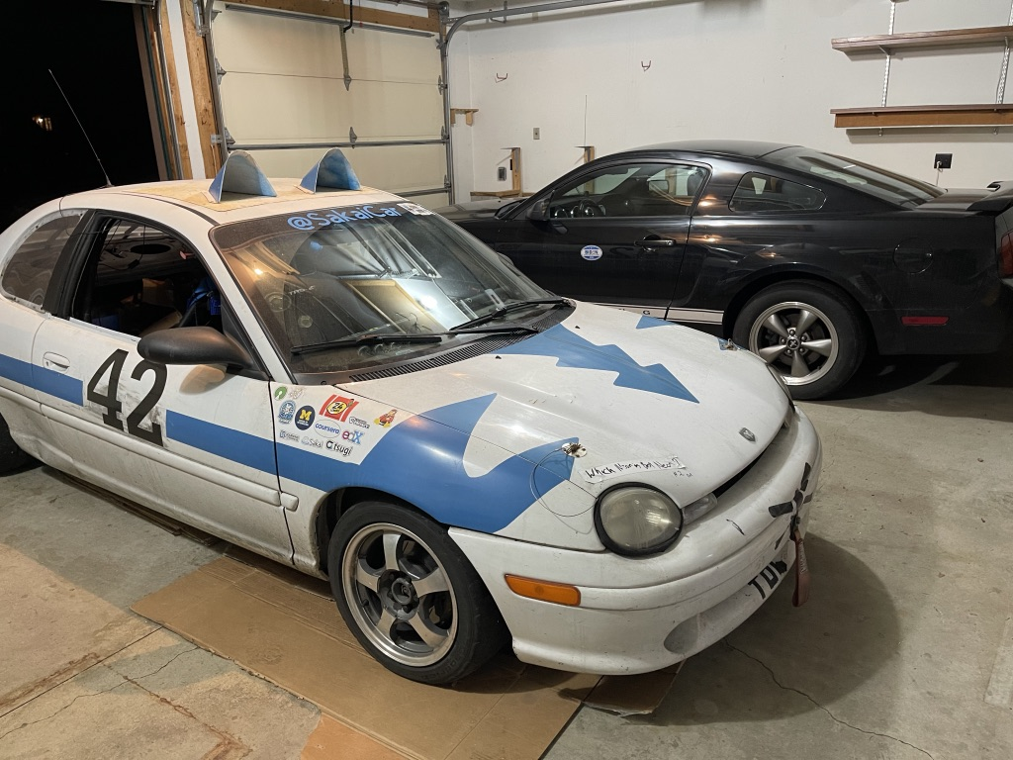

Should I slow down or even retire?

Slide 13
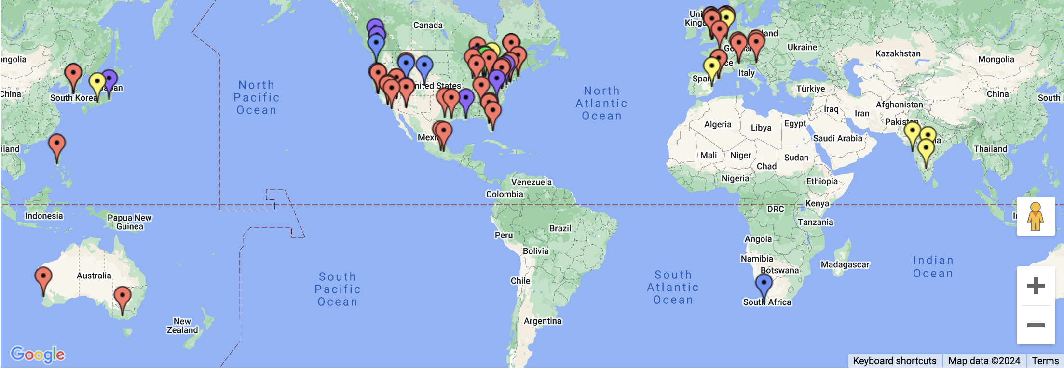
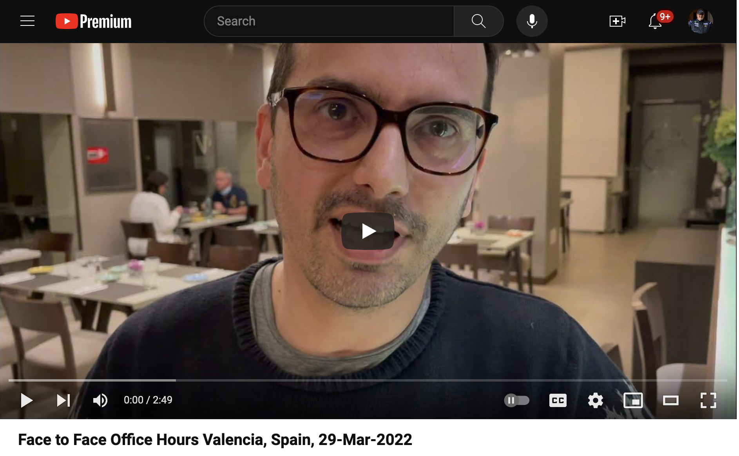

Slide 14
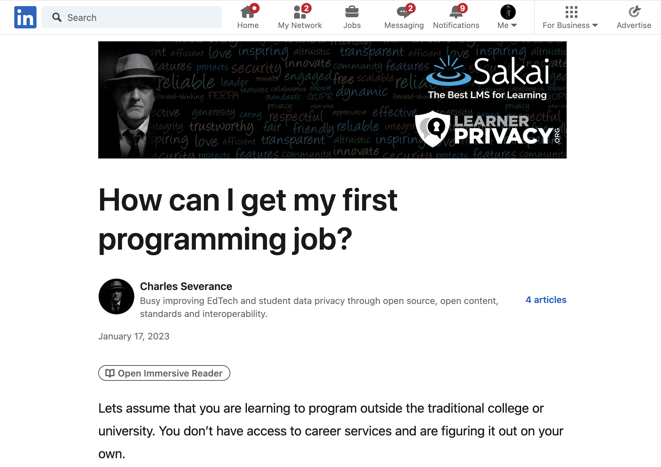

Slide 15

What kind of job can I get?

Slide 16
Would I hire the graduates of my "degree"?

Slide 17

A Brief Existential Crisis
Why am I here?
Have I let my students down?
Have I wasted their time?
Have I wasted my time?

Slide 18

Who would I hire?
I have met so many amazing developers over the years
Almost no Computer Scientists
Self taught / learned from mentors
Practical experience in large real-world projects
Work to build other people – great mentors
Not wizards – but quick learners

Slide 19

My next thought..

Slide 20
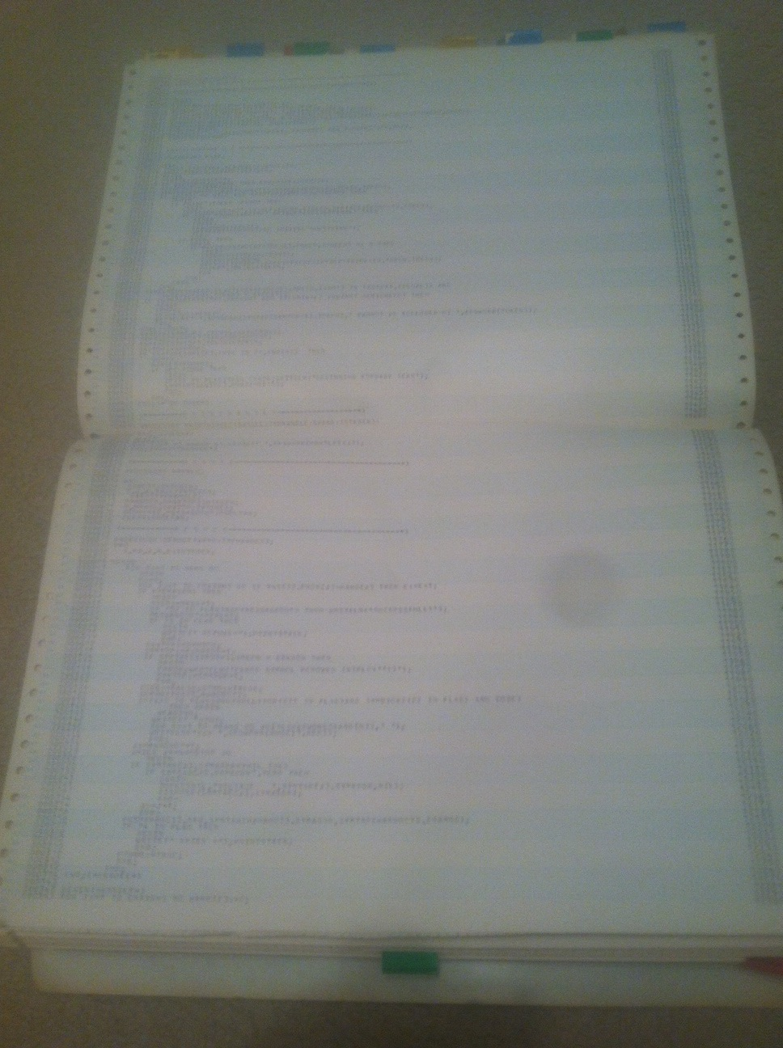
Master Programmers
Can learn any programming environment and master it in four weeks
See past the syntax
Run-time environments and data structures memory use, performance tradeoffs
Back in the 1970's and 1980s
It took 4 years
We wrote a compiler in year 4

Slide 21
Flask
SpringMVC
Rust
RedShift
BigData
Java
C#
Scala
JavaScript
HTML
Go
C++
VB
Fortran
AI
Kotlin
PHP
Node
JQuery
Perl
C
React
Dart
Backbone
R
ObjectiveC
Angular
Svelte
Lua
Ruby
COBOL
Django
SQL
Assembly
Swift
Python
Jupyter

Slide 22
Flask
SpringMVC
RedShift
BigData
Rust
Java
C#
Scala
JavaScript
HTML
Go
C++
VB
Fortran
AI
Kotlin
Node
PHP
C
React
JQuery
Perl
Dart
Backbone
Angular
R
ObjectiveC
Svelte
Lua
Ruby
COBOL
Django
SQL
Assembly
Swift
Python
Jupyter
???
???
???
???

Slide 23
Flask
SpringMVC
RedShift
BigData
Rust
Java
C#
Scala
JavaScript
HTML
Go
C++
VB
Fortran
AI
Kotlin
Node
PHP
C
React
JQuery
Perl
Dart
Backbone
Angular
R
ObjectiveC
Svelte
Lua
Ruby
COBOL
Django
SQL
Assembly
Swift
Jupyter
Python
???
???
???

Slide 24
Flask
SpringMVC
RedShift
BigData
Rust
Java
C#
Scala
JavaScript
HTML
Go
C++
VB
Fortran
AI
Kotlin
Node
PHP
React
JQuery
Perl
Dart
Backbone
Angular
R
ObjectiveC
Svelte
Lua
Ruby
COBOL
Django
Swift
Jupyter
Python
C
Architecture
Assembly
SQL

Slide 25
Flask
Rust
SpringMVC
RedShift
BigData
Java
C#
Scala
HTML
JavaScript
Go
C++
VB
Fortran
AI
Kotlin
Node
PHP
Perl
React
JQuery
Dart
Backbone
R
ObjectiveC
Angular
Svelte
COBOL
Django
Lua
Ruby
Swift
Jupyter
???
???
???
Python
C
Architecture
Assembly
SQL

Slide 26
Flask
SpringMVC
BigData
Rust
RedShift
Scala
C#
Fortran
Go
C++
VB
AI
Kotlin
PHP
React
Node
JQuery
Perl
Dart
Backbone
R
ObjectiveC
Angular
Svelte
Lua
Ruby
COBOL
Django
Swift
Jupyter
HTML
JavaScript
Java
Python
C
Architecture
Assembly
SQL

Slide 27
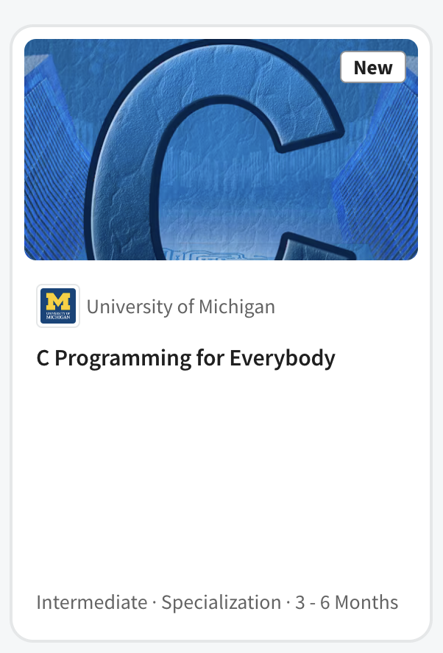

Slide 28
C Programming for Everybody
Uses 1978 edition of book to focus on historical impact of C
Online textbook with executable examples
Accessible audio book including code samples
Starts by comparing Python to C (Rosetta Stone)
48 Auto-graded assignments
Brower-based development and compiler environment
Ends with building Python objects in C
Extras
Interviews: Brian Kernighan, Bjarne Stroustrup, Guido van Rossum

Slide 29


C Programming for Everybody
Uses 1978 edition of book to focus on historical impact of C
Online textbook with executable examples
Accessible audio book including code samples
Starts by comparing Python to C (Rosetta Stone)
48 Auto-graded assignments
Brower-based development and compiler environment
Ends with building Python objects in C
Extras
Interviews: Brian Kernighan, Bjarne Stroustrup, Guido van Rossum

Slide 30
Who could be a professional programmer?
Pre-college students preparing for college
College students taking a challenging course
Working adults that want to take the next step in their career
Older adults with free time and want to "see if they can do it"
Successful people that want to try "something else"

Slide 31
My To Do List
Computer Architecture for Everybody
Modern JavaScript
Modern Java
Far off future: Scalable Internships…

Slide 32
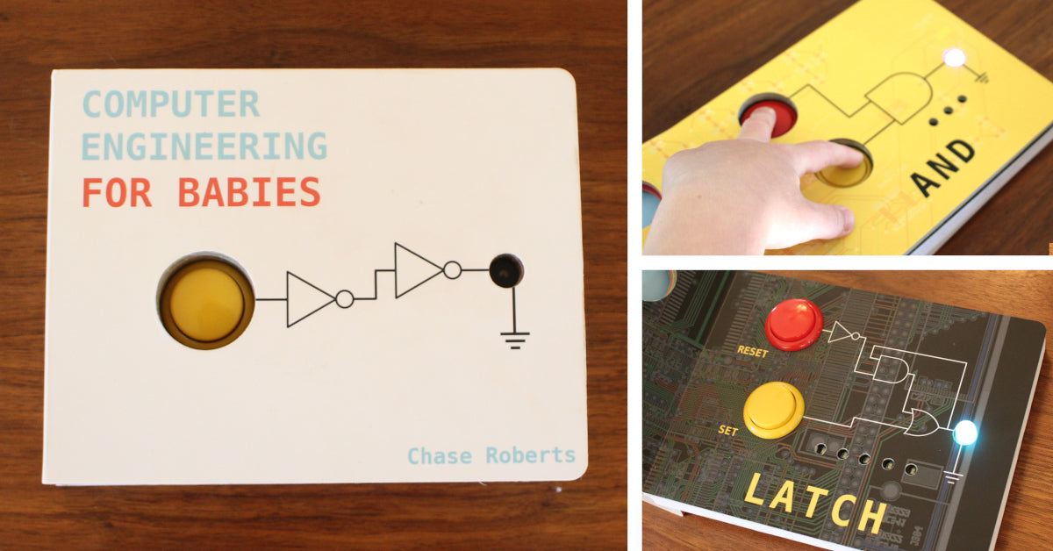

Slide 33
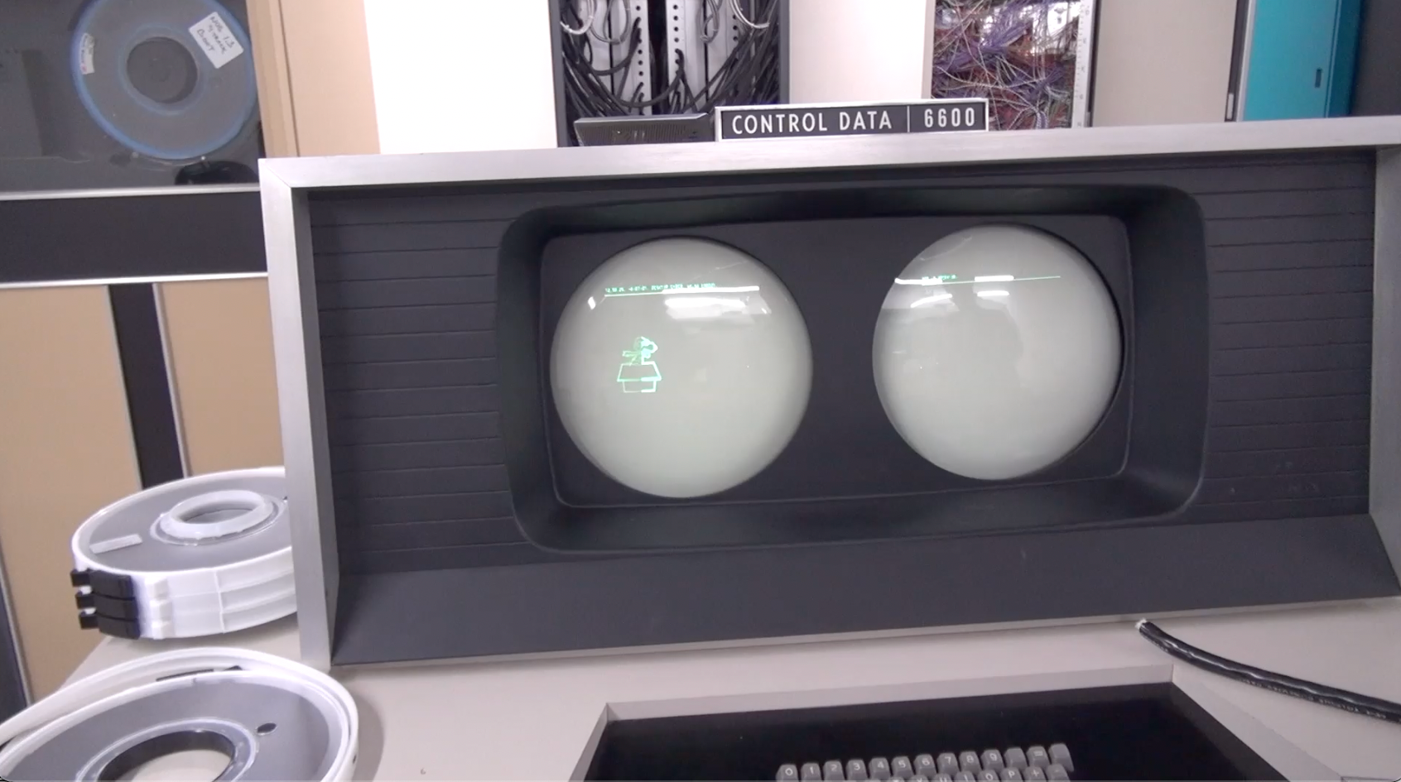
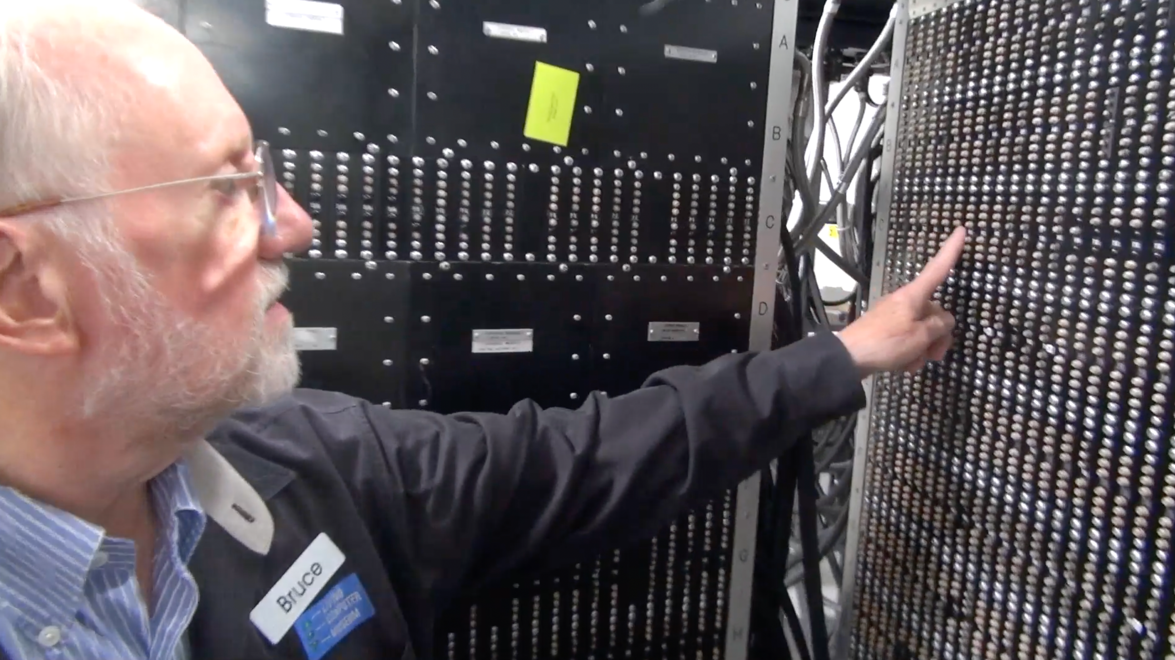
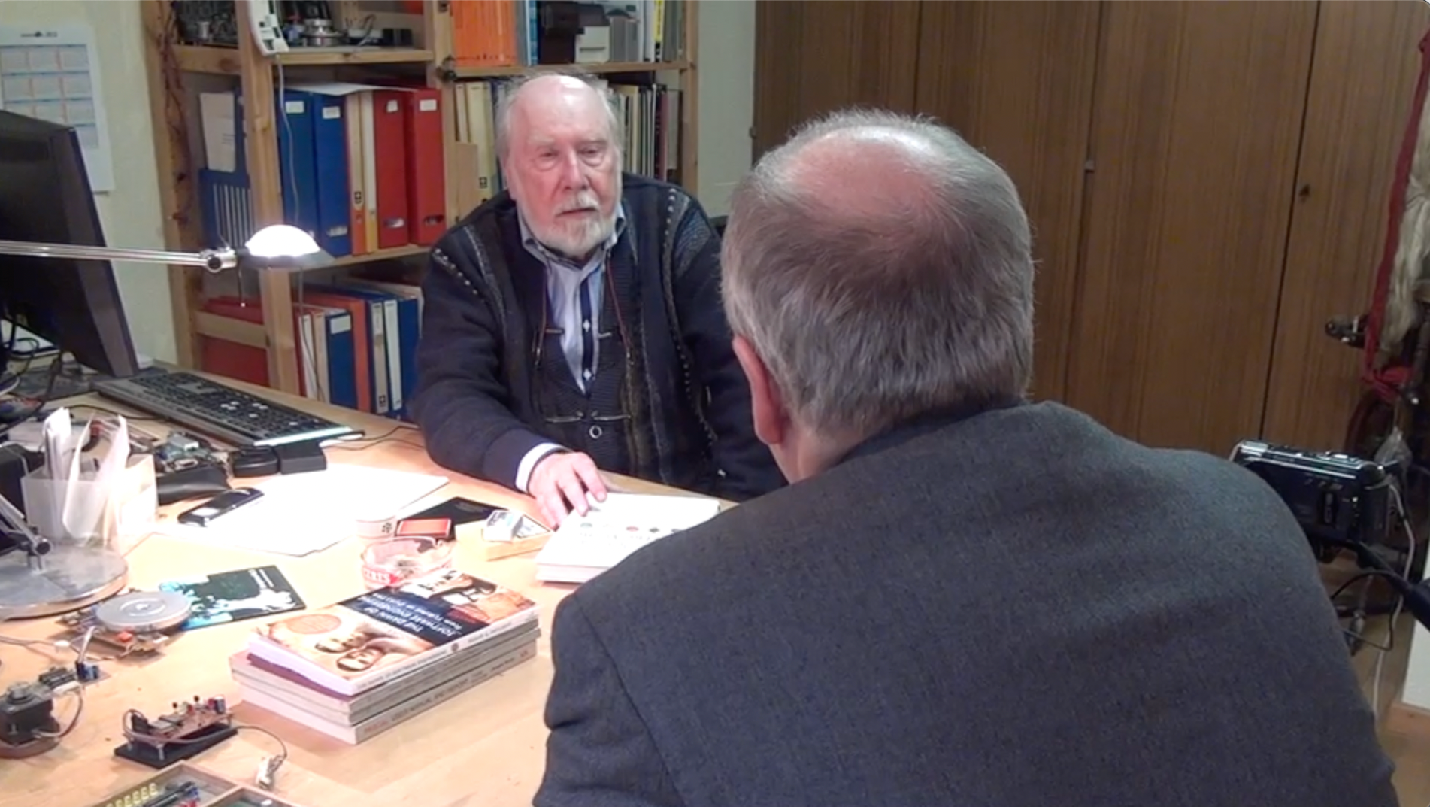
CDC 8512 - Inspired by CDC 6500
Control Data Corporation
Mid 1960’s – mid-1970’s
Dr. Chuck’s first computer
FORTRAN
Assembly Language
Pascal
https://en.wikipedia.org/wiki/CDC_6000_series#Central_processor

Slide 34

The Path to the Master Programmer
I have started down the path to build it
C Programming for Everybody is the first step
You can watch as I built it at plus.dr-chuck.com
Any questions?

